Slide 1
SORTING & SEARCHING.
Looking for data.

Slide 2
SORTING.
One of the most common data-processing applications.
The process through which data are arranged according to their values is called SORTING.
If data were not ordered, hours spent on trying to find a single piece of information.
Example: The difficulty of finding someone’s telephone number in a telephone book that had no internal order.

Slide 3
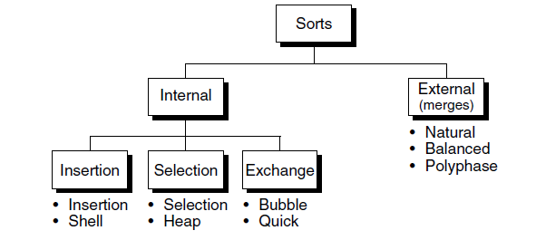
SORT CLASSIFICATIONS.

Slide 4
TYPES OF SORTS.
Uses primary memory for the current data being sorted.
Secondary storage for data not fitting in primary memory
All data are held in primary memory during the sorting process.
Internal
External

Slide 5
THREE INTERNAL SORTS.
Selection sort
Shell sort
Heap sort
Quick sort
Insertion sort
Bubble sort

Slide 6
SORT ORDER.
Data may be sorted in either ascending or descending sequence.
If the order of the sort is not specified, it is assumed to be ascending.
Examples of common data sorted in ascending sequence are the dictionary and the telephone book.
Examples of common descending data are percentages of games won in a sporting event such as baseball or grade-point averages for honor students.

Slide 7
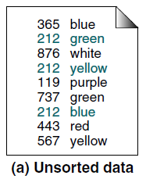
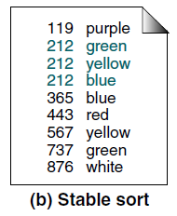
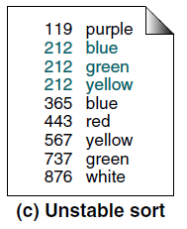
SORT STABILITY.
Is an attribute of a sort, indicating that data with equal keys maintain their relative input order in the output.
input order
output

Slide 8
SORT EFFICIENCY.
Is a measure of the relative efficiency of a sort, usually an estimate of the number of comparisons and moves required to order an unordered list.
Best possible sorting algorithms are the O(n log n) sorts.

Slide 9
PASSES.
During the sorting process, the data are traversed many times. Each traversal of the data is referred to as a sort pass.
Depending on the algorithm, the sort pass may traverse the whole list or just a section of the list.
Also, a characteristic of a sort pass is the placement of one or more elements in a sorted list.

Slide 10
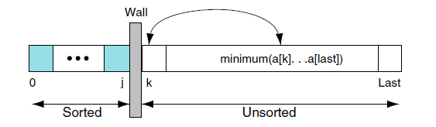
SELECTION SORT.
In each pass of the selection sort, the smallest element is selected from the unsorted sublist and exchanged with the element at the beginning of the unsorted list.
If there is a list of n elements, therefore, n – 1 passes are needed to completely rearrange the data.

Slide 11
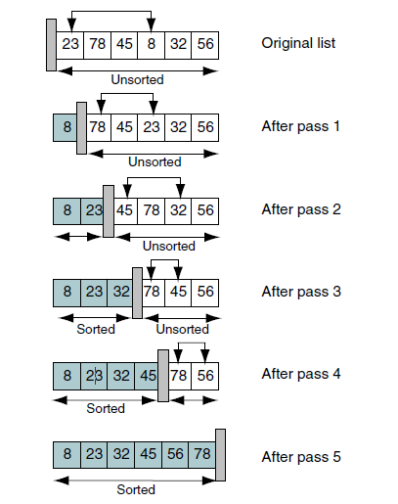
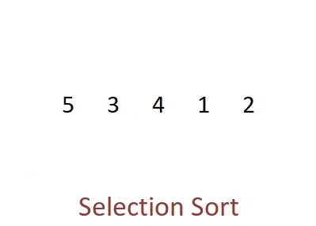
SELECTION SORT.
Example 2

Slide 12
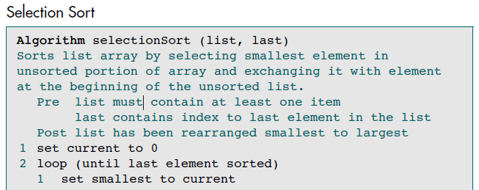
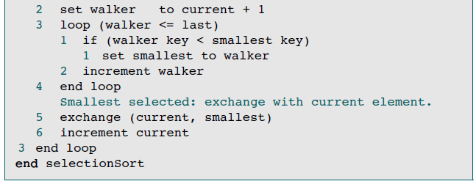

Slide 15
Selection Sort Efficiency.
It contains the two loops.
The outer loop executes n – 1 times. The inner loop also executes n – 1 times.
This is a classic example of the quadratic loop. Its search effort therefore, using big-O notation, is O(n²).

Slide 16
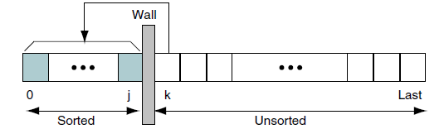
INSERTION SORT.
Given a list, it is divided into two parts: sorted and unsorted.
In each pass the first element of the unsorted sublist is transferred to the sorted sublist by inserting it at the appropriate place.
If list has n elements, it will take at most n – 1 passes to sort the data.

Slide 17
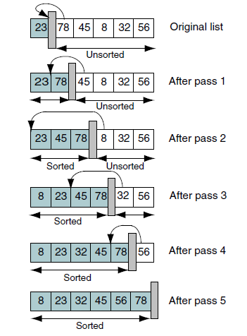
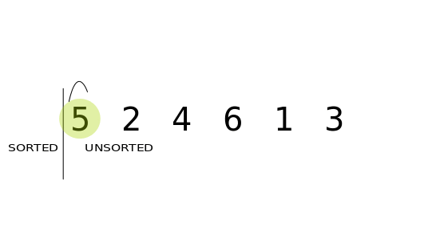
INSERTION SORT.

Slide 18
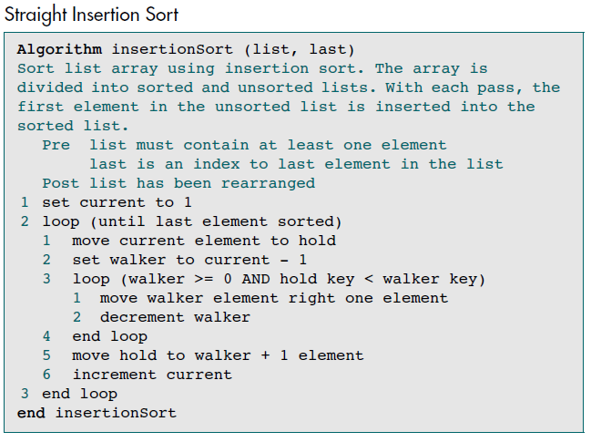

Slide 20
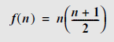
INSERTION SORT EFFICIENCY.
The outer loop executes n – 1 times, from 1 through the last element in the list.
For each outer loop, the inner loop executes from 0 to current times, depending on the relationship between the hold key and the walker key.
On the average, the inner loop processes through the data in half of the sorted list. Because the inner loop depends on the setting for current, which is controlled by the outer loop, we have a dependent quadratic loop, which is mathematically stated as
In big-O notation the dependent quadratic loop is O(n²).
Therefore, the insertion sort efficiency is O(n²).

Slide 21
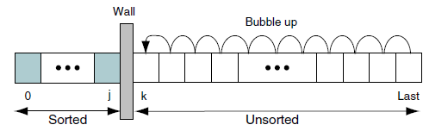
BUBBLE SORT.
The list is divided into two sublists: sorted and unsorted.
The smallest element is bubbled from the unsorted sublist and moved to the sorted sublist.
After moving the smallest to the sorted list, the wall moves one element to the right, increasing the number of sorted elements and decreasing the number of unsorted ones.
Each time an element moves from the unsorted sublist to the sorted sublist, one sort pass is completed.
Given a list of n elements, the bubble sort requires up to n – 1 passes to sort the data.

Slide 22
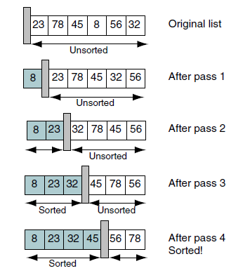

BUBBLE SORT.

Slide 23
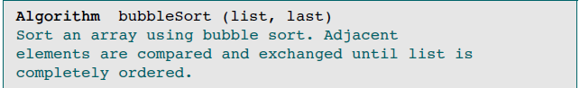
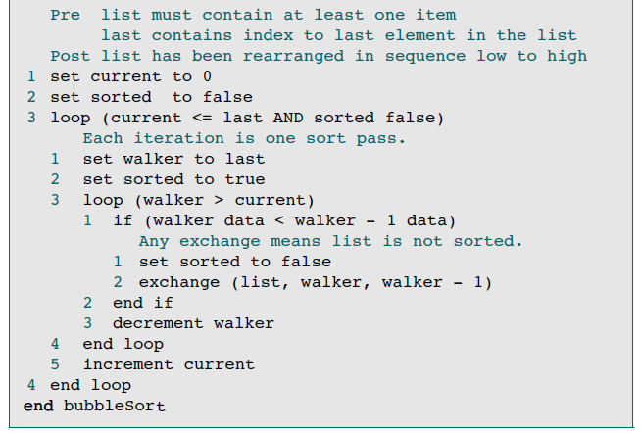

Slide 25
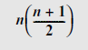
BUBBLE SORT EFFICIENCY.
Uses two loops to sort the data.
The outer loop tests two conditions: the current index and a sorted flag.
Assuming that the list is not sorted until the last pass, we loop through the array n times. The number of loops in the inner loop depends on the current location in the outer loop. It therefore loops through half the list on the average. The total number of loops is the product of both loops, making the bubble sort efficiency to
The bubble sort efficiency is O(n²).

Slide 26
QUICK SORT.
In Quick sort, also an exchange sort method, developed by C. A. R. Hoare in 1962.
Quick sort is an exchange sort in which a pivot key is placed in its correct position in the array while rearranging other elements widely dispersed across the list.
More efficient than the bubble sort because a typical exchange involves elements that are far apart, so fewer exchanges are required to correctly position an element.
Notes:
In the bubble sort, consecutive items are compared and possibly exchanged on each pass through the list, which means that many exchanges may be needed to move an element to its correct position.

Slide 27
QUICK SORT.
Also called partition-exchange sort.
Each iteration of the quick sort selects an element, known as pivot, and divides the list into three groups:
Partition of elements whose keys are less than the pivot’s key,
Pivot element placed in its ultimately correct location in the list,
Partition of elements greater than or equal to the pivot’s key.
Pivot element can be any element from the array, it can be the first element, the last element or any random element.
Approach is recursive.

Slide 28
LOGIC OF PARTITION.
In the array {52, 37, 63, 14, 17, 8, 6, 25} , 25 is taken as pivot.
First pass: {6, 8, 17, 14, 25, 63, 37, 52}
After the first pass, pivot will be set at its position in the final sorted array, with all the elements smaller to it on its left and all the elements larger than to its right.
Next, {6 8 17 14} and {63 37 52} are considered as two separate subarrays
Same recursive logic will be applied on them, and keep doing this until the complete array is sorted.

Slide 29
HOW DOES QUICK SORT WORK?
Selection of pivot to partition the array
Pivot (key) = First element; Find a position for it
Left partition < pivot, Right partition $≥$pivot
Repeat recursively for Left and Right partitions
Can be used for finding the k^{th} smallest OR largest element in an array without completely sorting the array of size n.
When the pivot element is placed in (k-1)^{th} position, it will be the k^{th} smallest element
When the pivot element is placed in (n-k)^{th} position, it will be the k^{th} largest element

Slide 30
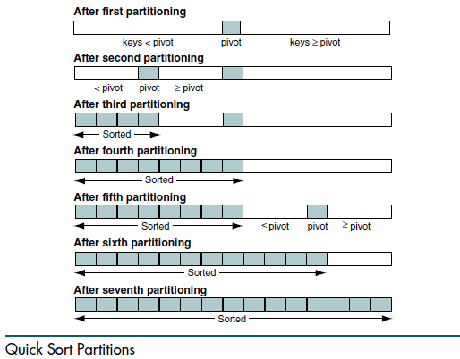
QUICK SORT ALGORITHM.
Two Algorithms:
Quick Sort Recursive
Partition

Slide 31
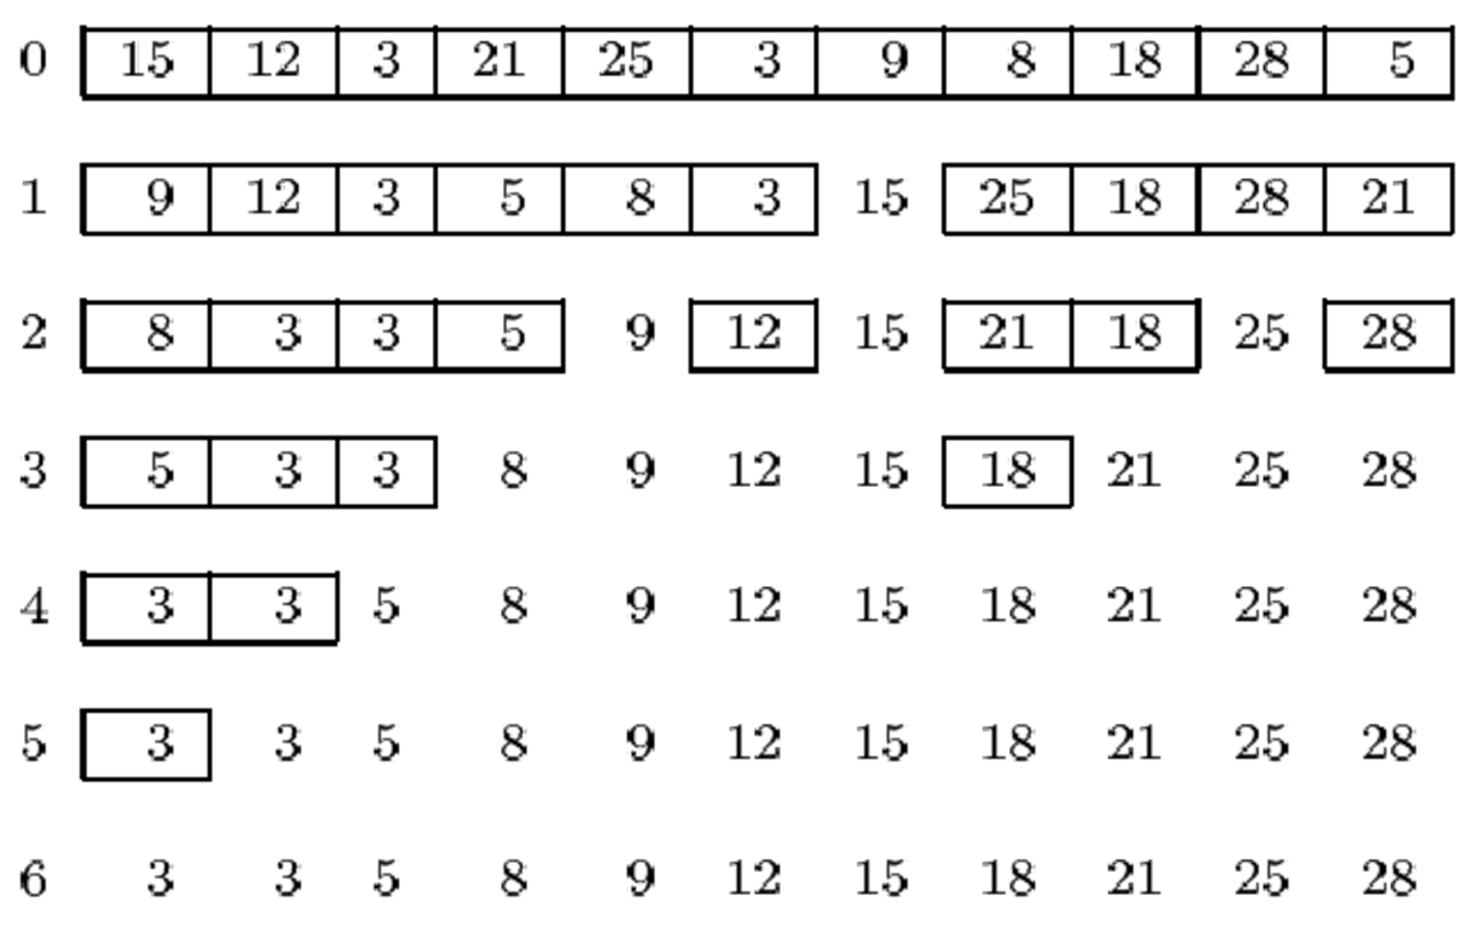
QUICK SORT EXAMPLES.

Slide 32
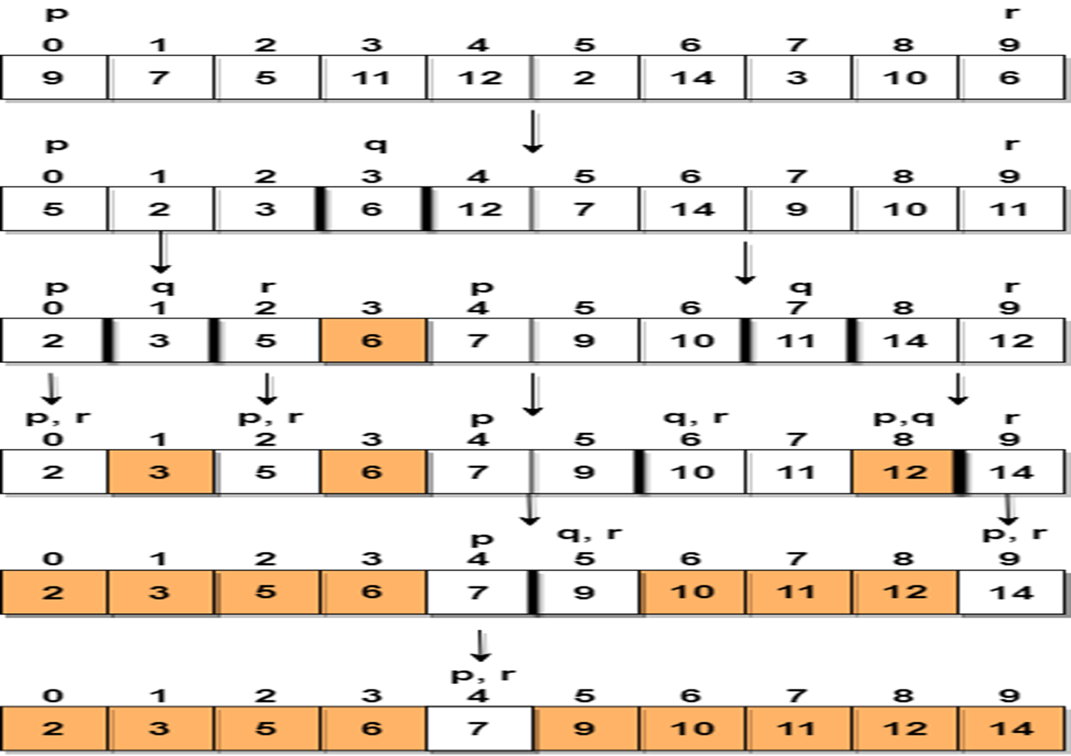
QUICK SORT EXAMPLES.
Pivot Element = 6

Slide 33
QUICK SORT ALGORITHM.
Algorithm Quicksort (Array, Low, High)
If (Low < High) Then
Set Mid = Partition (Array, Low, High)
Quicksort (Array, Low, Mid – 1)
Quicksort (Array, Mid + 1, High)
End

Slide 34
QUICK SORT ALGORITHM.
Algorithm Partition (Array, Low, High)
Set Key = Array[low], I = Low + 1, J = High
Repeat Steps A through C
while (I < High && Key ≥ Array[i]) i++
while (Key < Array[j]) j- -
if (I < J) then
swap Array[i] with Array[j]
else
swap Array[low] with Array[j]
return j {Position For KEY}
End

Slide 35
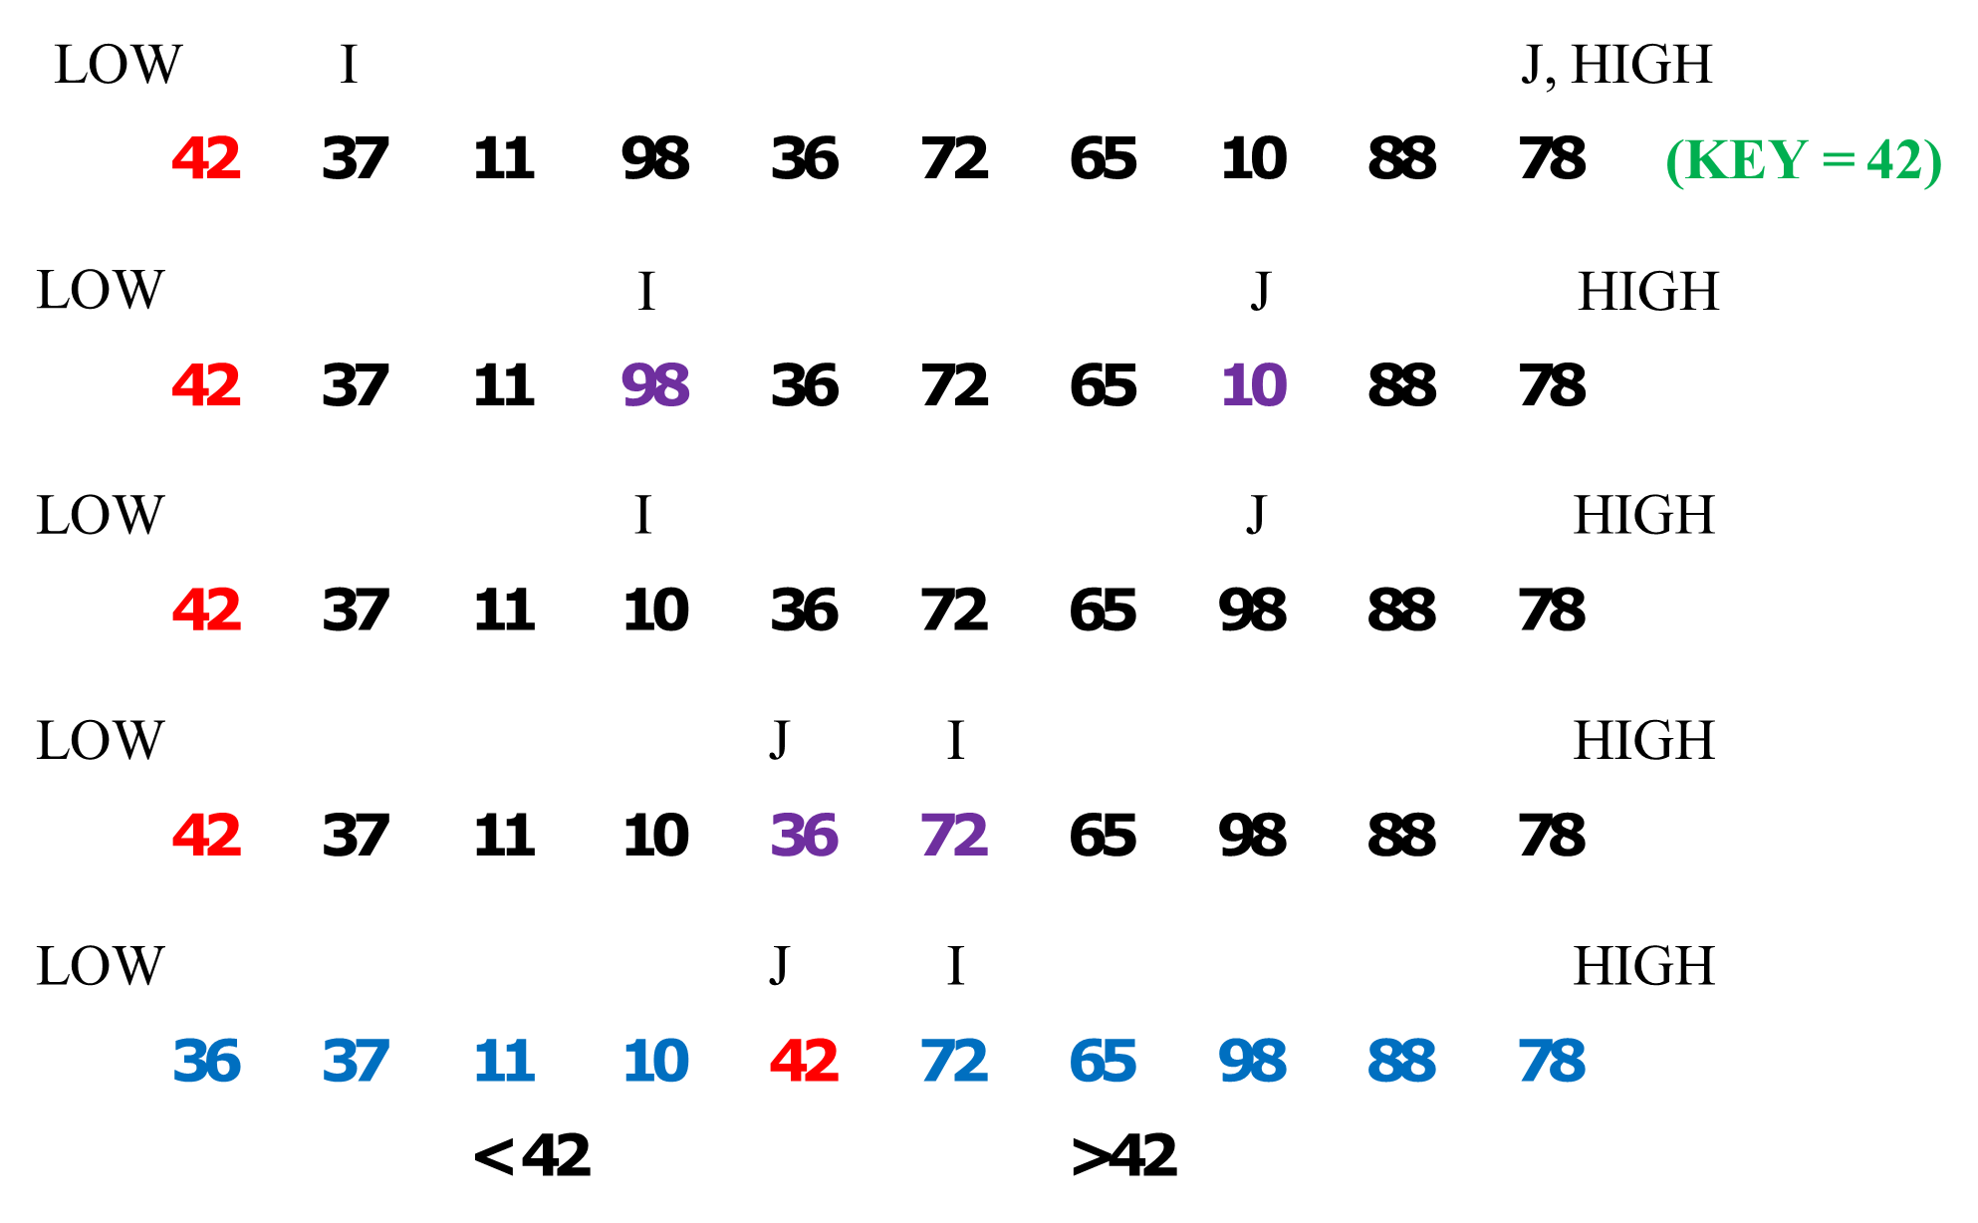
QUICK SORT EXAMPLES. (PARTITIONS)

Slide 36
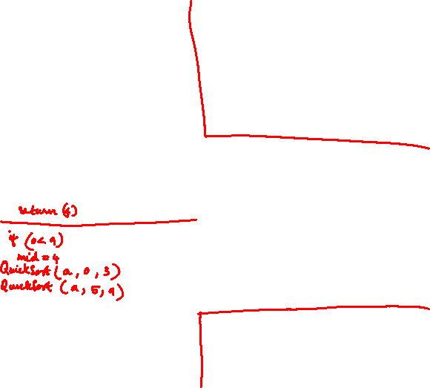
Set Key = Array[low], I = Low + 1, J = High
Repeat Steps A through C
while (I < High && Key ≥ Array[i]) i++
while (Key < Array[j]) j- -
if (I < J) then
swap Array[i] with Array[j]
else
swap Array[low] with Array[j]
return j {Position For KEY}
Algorithm Quicksort (Array, Low, High)
If (Low < High) Then
Set Mid = Partition (Array, Low, High)
Quicksort (Array, Low, Mid – 1)
Quicksort (Array, Mid + 1, High)
End

Slide 37
QUICK SORT EFFICIENCY.
Quick sort is considered the best general-purpose sort known today.
To calculate the complexity of quick sort, the number of comparisons to sort an array of n elements (index ranges from 0 to n – 1) is f(n), given the following:
An array of zero or one element is already sorted. This means f(0) = f(1) = 0.
If pivot is at index i, two subarrays exist. The left subarray has (i) elements, and the right subarray has (n – 1 – i) elements.
The number of comparisons to sort the left subarray is f(i), and the number of comparisons to sort the right subarray is f (n – 1 – i), where i can be between 0 to n – 1.
To continuously divide the array into subarrays, n comparisons needed.
The efficiency of quick sort is O(n log n).

Slide 38
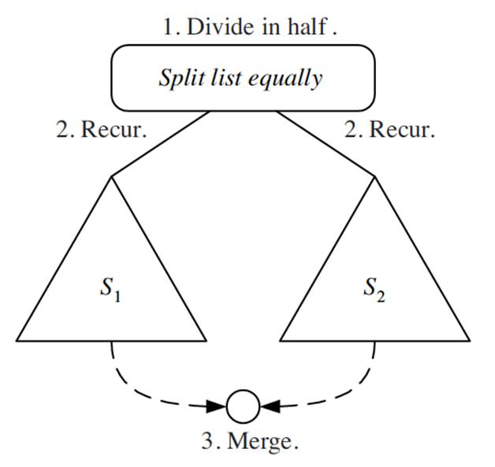
DIVIDE & CONQUER.
Divide-and conquer is a general algorithm design paradigm.
Divide: divide the input data S in two disjoint subsets S1 and S2.
Recur: solve the subproblems associated with S1 and S2.
Conquer: combine the solutions for S1 and S2 into a solution for S.
Base case for recursion are subproblems of size 0 or 1.

Slide 39
MERGE SORT.
Invented by John von Neumann in 1945, example of Divide & Conquer.
Repeatedly divides the data in half, sorts each half, and combines the sorted halves into a sorted whole.
Basic algorithm:
Divide the list into two roughly equal halves.
Sort the left half.
Sort the right half.
Merge the two sorted halves into one sorted list.
Often implemented recursively
Runtime: O(n log n).

Slide 40
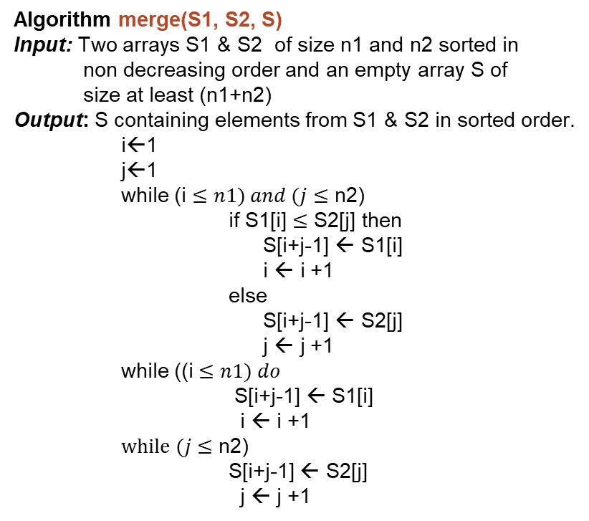
MERGE SORT ALGORITHM.
Algorithm merge(S1, S2, S)
Input: Two arrays S1 & S2 of size n1 and n2 sorted in
non decreasing order and an empty array S of
size at least (n1+n2)
Output: S containing elements from S1 & S2 in sorted order.
i←1
j←1
while (i $≤n1) and (j$ $≤$ n2)
if S1[i] $≤$ S2[j] then
S[i+j-1] ← S1[i]
i ← i +1
else
S[i+j-1] ← S2[j]
j ← j +1
while ((i $≤n1) do$
S[i+j-1] ← S1[i]
i ← i +1
$while (j$ $≤$ n2)
S[i+j-1] ← S2[j]
j ← j +1
Algorithm mergeSort(S)
Input: Sequence S with n elements
Output: Sequence S sorted
if S.size() > 1
(S1, S2) ← partition(S, n/2)
mergeSort(S1)
mergeSort(S2)
S ← merge(S1, S2)

Slide 41
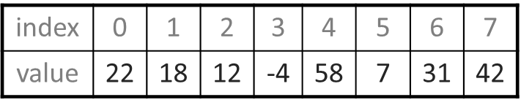
Merge Sort example.
split
22 | 18 | 12 | -4
58 | 7 | 31 | 42
split
split
22 18
12 -4
58 7
31 42
split
split
split
split
22
18
12
-4
58
7
31
42
merge
merge
merge
merge
18 22
-4 12
7 58
31 42
merge
merge
-4 | 12 | 18 | 22
7 | 31 | 42 | 58
merge
-4 | 7 | 12 | 18 | 22 | 31 | 42 | 58

Slide 42
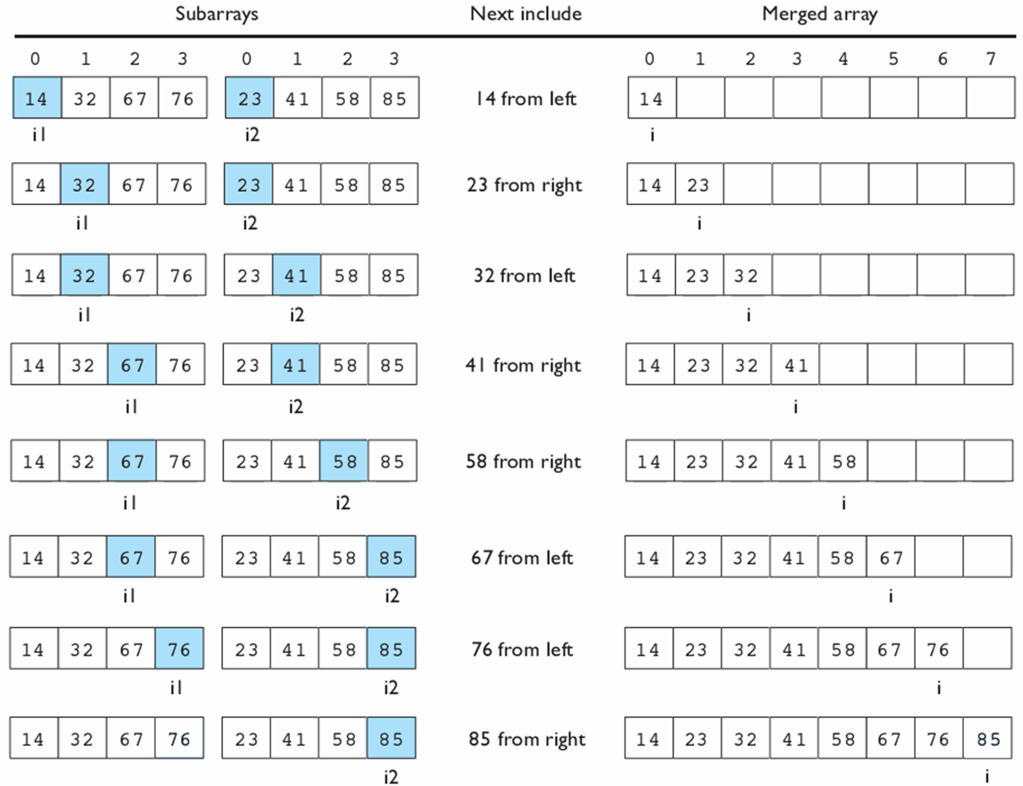
Merge Sort example.

Slide 43
SEARCHING.
One MORE common and time-consuming operations in computer science is searching
The process used to find the location of a target among a list of objects.
The two basic search algorithms:
Sequential search including three interesting variations and,
Binary search.

Slide 44
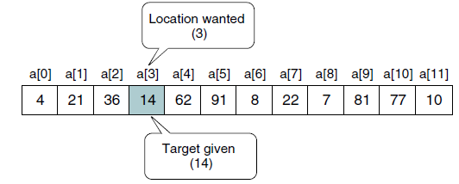
SEQUENTIAL SEARCH.
Used whenever the list is not ordered.
Generally, technique used only for small lists or lists that are not searched often.
Process: Start searching for the target at the beginning of the list and continue until target found or it is not in the list.
This approach has two possibilities: Find element (successful) or reach end of list (unsuccessful).

Slide 45
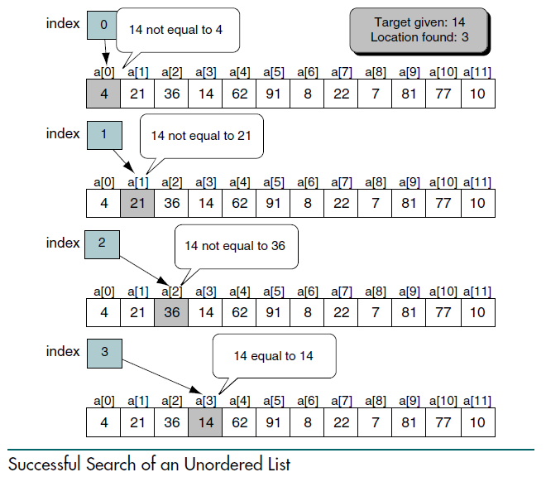
Sequential Search Example for Successful search.

Slide 46
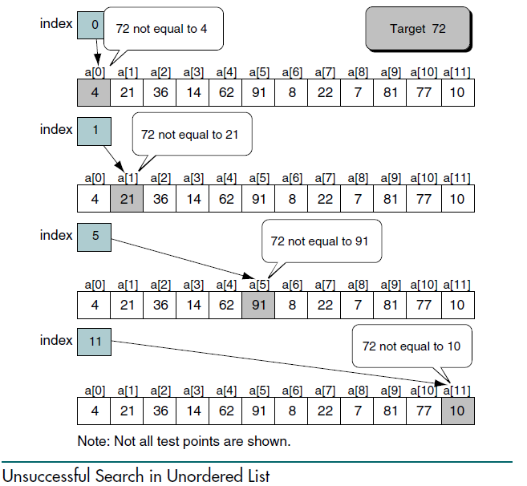
Sequential Search Example for Unsuccessful search.

Slide 47
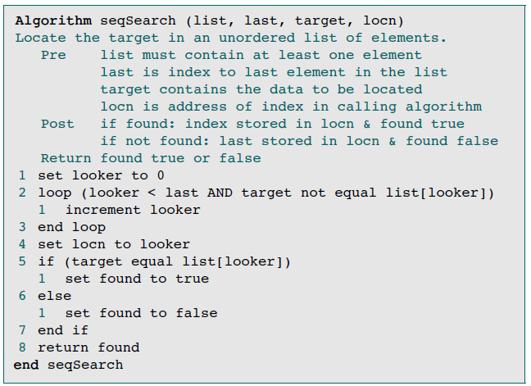
Efficiency of the sequential search is O(n).

Slide 48
BINARY SEARCH.
Sequential search algorithm is very slow. If an array of 1000 elements, exists, 1000 comparisons are made in worst case.
If the array is not sorted, the sequential search is the only solution.
However, if the array is sorted, we can use a more efficient algorithm called binary search.
Generally speaking, Binary search used whenever the list starts to become large.

Slide 49
BINARY SEARCH.
Begins by testing the data in the element at the middle of the array to determine if the target is in the first or the second half of the list.
If target in first half, there is NO need to check the second half.
If target in second half, NO need to test the first half.
In other words, half the list is eliminated from further consideration with just one comparison.
This process repeated, eliminating half of the remaining list with each test, until target if found or does not exist in the list.
To find the middle of the list, three variables needed: one to identify the beginning of the list, one to identify the middle of the list, and one to identify the end of the list.

Slide 50
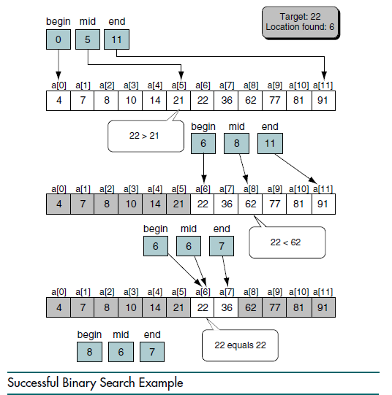
Binary Search Example for Successful search.

Slide 51
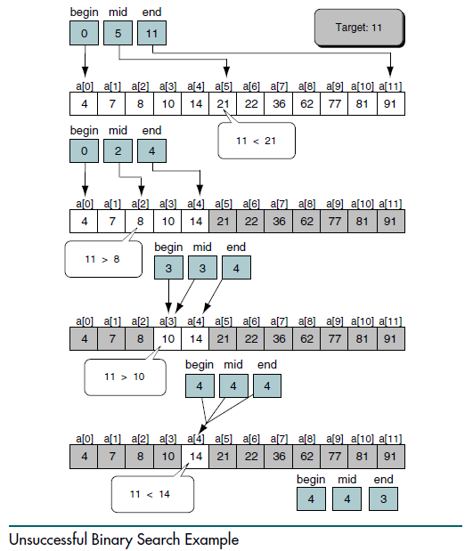
Binary Search Example for Unsuccessful search.

Slide 52
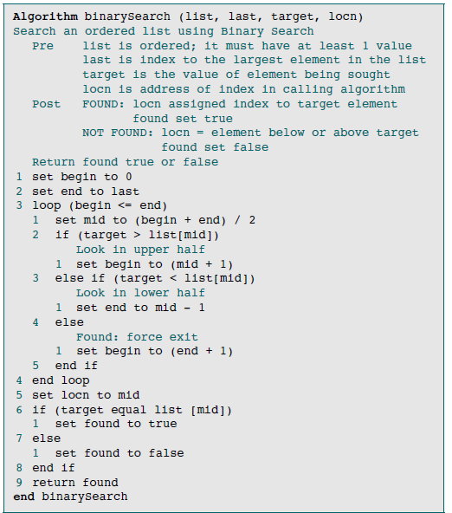
Efficiency of the binary search is O(log n).

Slide 53
End for today.

Slide 54
THE END FOR TODAY

